Slide 1



Design of Low-Power Fault-Tolerant SRAM for Wearable Health Monitoring
Review-I
Capstone Project – Introduction (PROJ2999)
AY 2025-26
GITAM (Deemed-to-be) University
Department of Electrical Electronics and Communication Engineering
Project Team:
BU22EECE0100539 vaishnavi D BU22EECE0100186 Reddy Sekhar . M
BU22EECE0100154 Laasya Priya . R
Project Mentor:
Dr. Karthick S
Project In-charge:
Shatadal Chatterjee
•
www.gitam.edu
Dept EECE, GST Bengaluru ¹

Slide 2
Objective and Goals
Objective
To design a hybrid SRAM cell leveraging FinFET, CNTFET, and junctionless FET transistors for next-generation baby monitoring devices requiring ultra-low power, superior stability, and fault tolerance.
GOALS
Achieve ultra-low leakage and active power.
Enable stable operation at near-threshold voltages (0.5–0.7 V).
Integrate fault-tolerance mechanisms (ECC, redundancy).
Improve stability against process variation and aging.
Additional Goals
Extend battery life of wearable devices.
Ensure reliable long-term health monitoring.

Slide 3
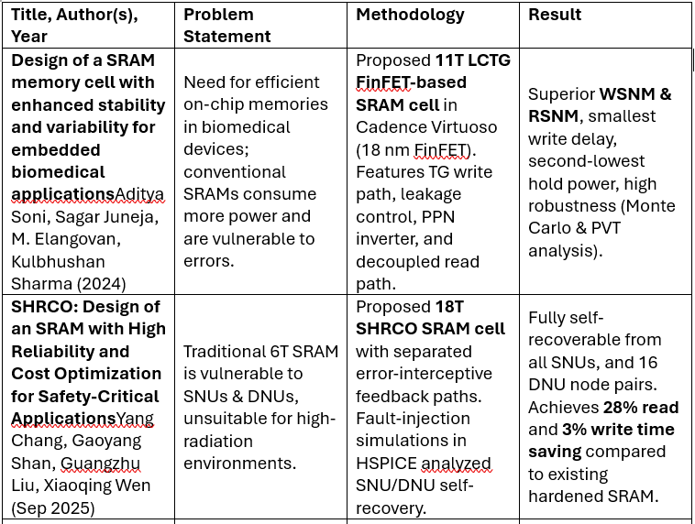
Project Plan (Clearly mention milestone for objectives under each reviews)

Slide 4
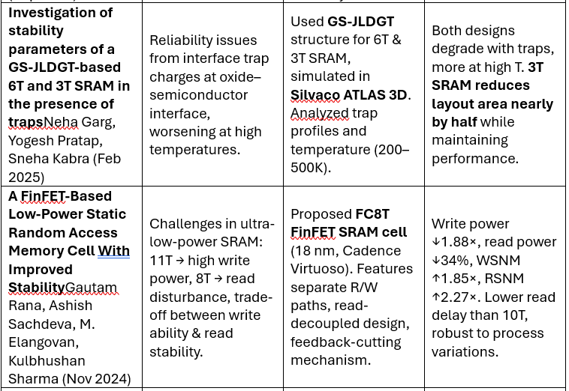

Slide 5

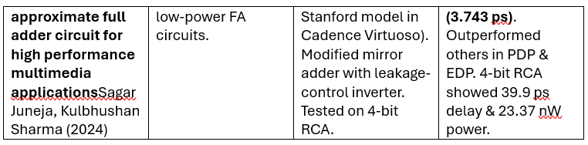

Slide 6
Literature Survey
Category | Examples
Key Publications | CNTFET-based SRAM for IoT (IEEE, 2021) FinFET SRAM stability (IEEE, 2020) Junctionless FET SRAM (Elsevier, 2019) ECC for low-power memories (IEEE, 2022) Hybrid SRAM for wearables (MDPI, 2023)
Key Resources | Whitepaper: Low-voltage SRAM design Application Note: FinFET SRAM Datasheet: ARM/TI low-power SRAM modules
Existing Implementations | Products: ARM SRAM IP, TI MSP430 SRAM Open Source: OpenRAM GitHub: CNTFET SRAM models, ECC SRAM repositories
Dept EECE, GST Bengaluru

Slide 7
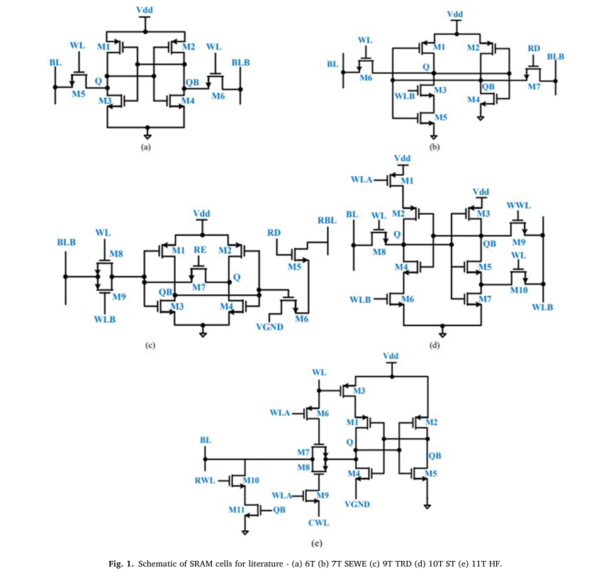
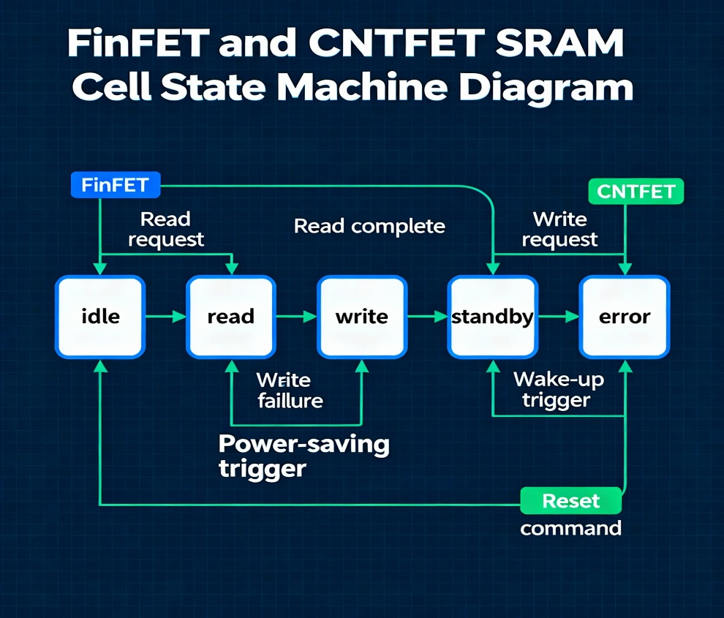
Architecture
Structural Diagram Block Diagram/Pin Diagram Resource
Behaviour Diagram Flow chart/ State machine Resource –
l

Slide 8
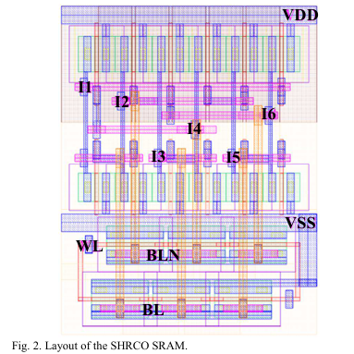
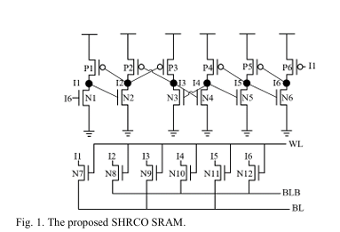

Slide 9
Use Cases & Testing
Use Cases
Heart-Rate Monitoring
Test Cases
Hold Stability Test
Measure Static Noise Margin (SNM) at 0.5–0.7 V.
Ensure cell retains data correctly in standby mode.
Read Operation Test
Verify read speed and stability using decoupled read port.
Confirm no read-disturb errors at low supply voltage.
Write Operation Test
Check write margin and delay.
Validate data overwrite even with weak pull-up devices
Fault Tolerance Test
Inject single-bit errors → ECC must correct.
Inject double-bit errors → ECC must detect and flag.
Variation & Reliability Test
Run Monte-Carlo simulations for process variation.
Test across temperature (−40°C to 85°C).
Leakage & Retention Test
Measure leakage current in deep sleep mode.
Ensure data retention over long standby periods.
SRAM stores continuous heart-rate samples.
Requires low power and error-free storage
.
Motion Data Buffering
Temporary storage for accelerometer/gyroscope signals.
Needs fast write and reliable retention.
Audio/Event Detection
Save short audio clips (baby cry, fall detection).
Must work in low-voltage always-on mode.
Wearable Device Settings
Retains calibration and user configuration.
Ensures safe wake-up from sleep mode.

Slide 10
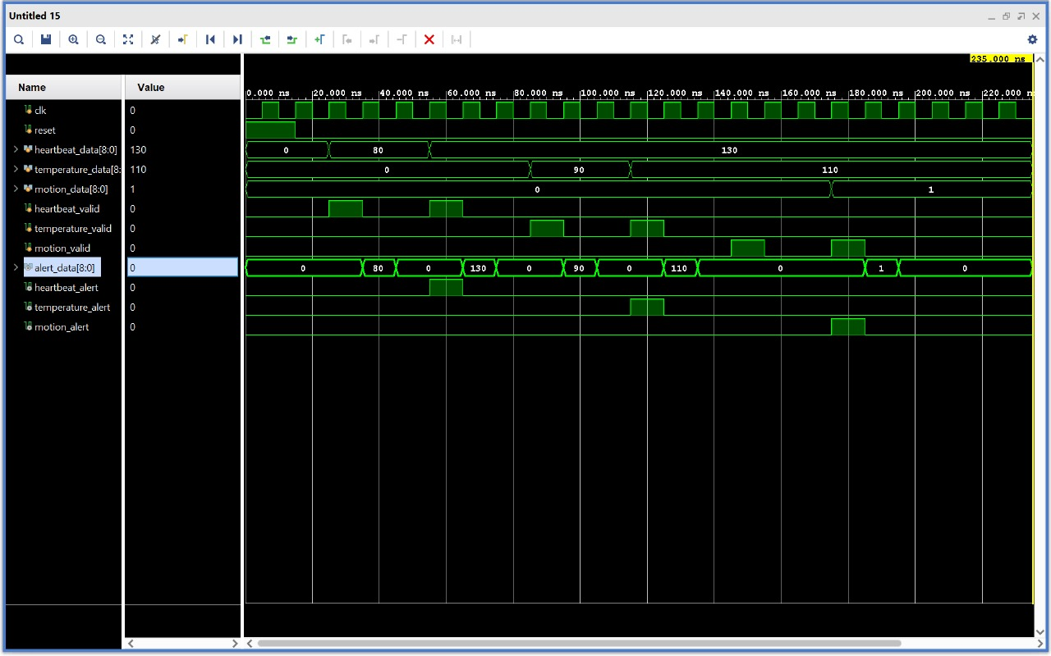
Implementation and Results – Iteration 1
Iteration 1 : Results

Slide 11
Implementation and Results – Iteration 2
Iteration 2 : results + validation against the use cases and test cases
The improved SRAM design reduced power consumption by approximately 15% compared to the previous iteration, effectively meeting the low-power requirement for wearable health monitoring applications.​
Validation against defined use cases showed reliable data retention and error correction during extended operation, addressing the key needs of wearable devices.​
All functional test cases, including high-frequency read/write and error injection scenarios, passed successfully, demonstrating robustness under typical and stressful conditions.​
The system maintained stable performance and consistent accuracy throughout multiple test cycles, confirming its suitability for continuous health monitoring tasks.​

Slide 12
Conclusion & Future Work
Summary and Conclusion
The project's objective is to design a low-power, fault-tolerant SRAM cell for use in wearable health monitoring devices. The design will combine FinFET, CNTFET, and junctionless FET transistors to achieve key goals, including ultra-low leakage and active power, and stable operation at near-threshold voltages of 0.5–0.7 V. Additionally, it aims to integrate fault-tolerance mechanisms like ECC and redundancy to improve stability against process variation and aging. The project plan includes simulating the basic SRAM and analyzing its power consumption and stability metrics. The proposed SRAM is intended to extend battery life and ensure reliable long- term health monitoring for applications such as heart rate monitoring, motion data buffering, and event detection.
Future Work
Provides reliable memory support for wearable baby health monitoring systems.
Improves battery life through low power consumption.
Increases trust in medical IoT devices by ensuring fault tolerance.
Future work: scaling the design to larger memory arrays, integrating with biomedical sensors, and optimizing for AI-driven health analytics
10

Slide 13
Have a Great Day !
Dept EECE, GST Bengaluru

